Slide 1
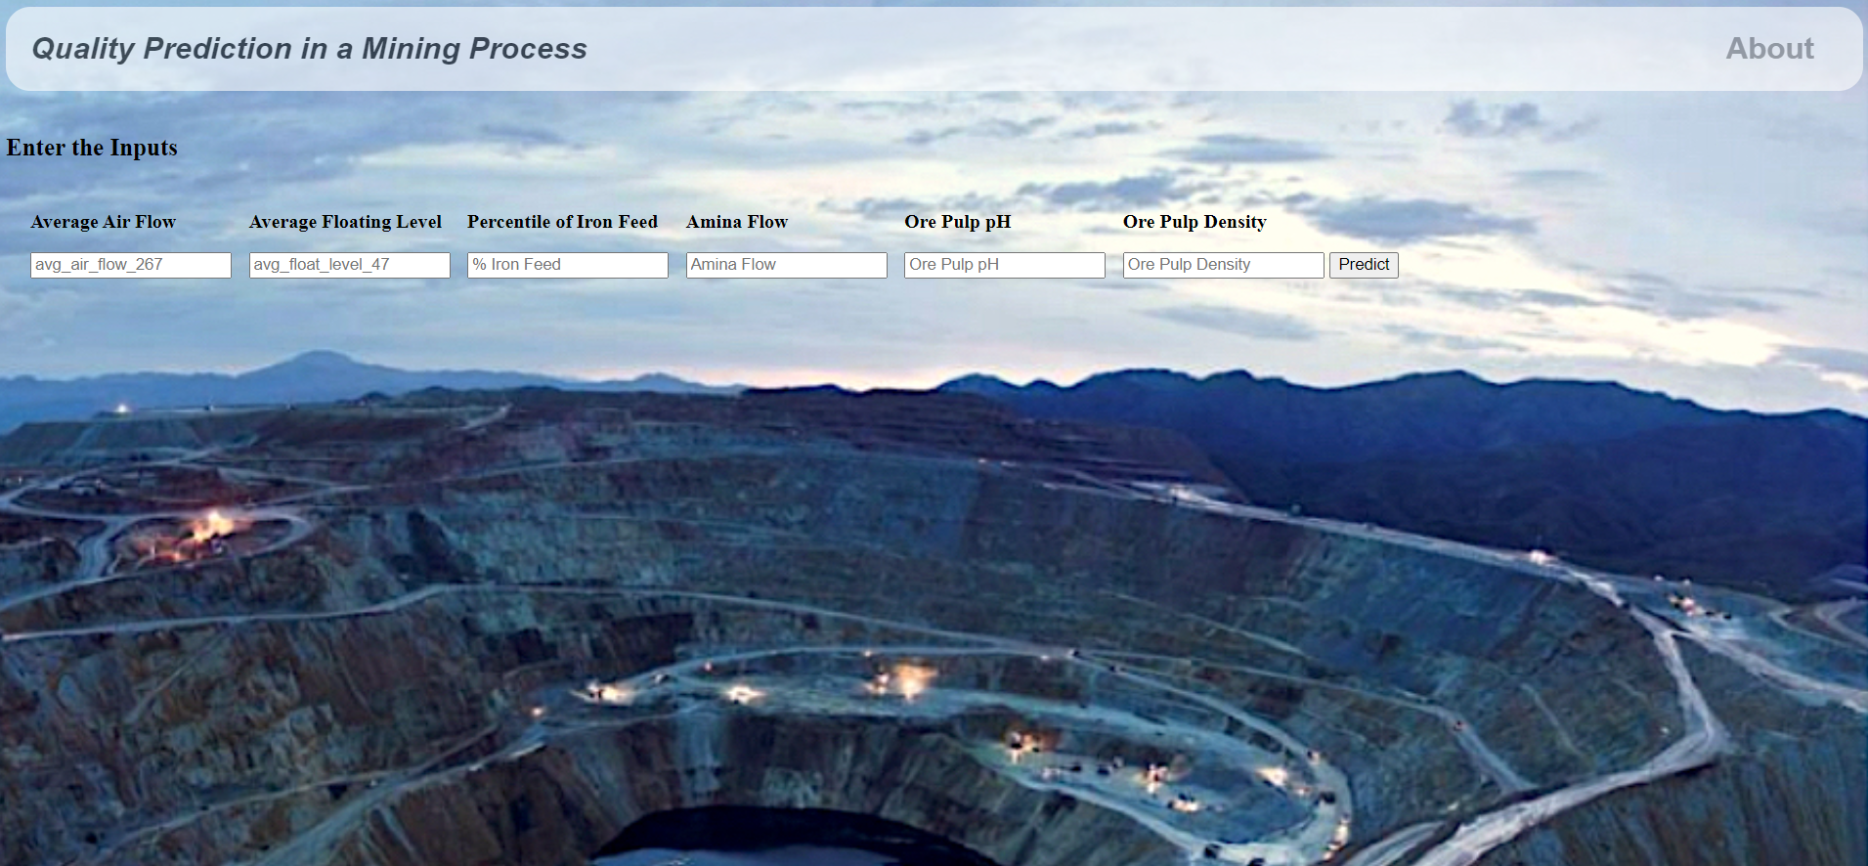

Slide 2

Estimate The Presence Of Impurities In An Iron Ore
DEPARTMENT OF COMPUTER SCIENCE AND ENGINEERING
Ch. Keerthi Sai 18481A0545
D. Prathyusha 18481A0557
B. Harish Chandra 18481A0525
Ch. Lakshmi Pallavi 18481A0549

Slide 3
INTRODUCTION
Iron ores are rocks and minerals from which metallic iron can be economically extracted. Iron is usually found in the form of Magnetite, Hematite, Goethite, Limonite, or Siderite.
Usually, Magnetite Iron ore concentrate contains an impurity of 3–7% of silica. Estimation of silica involves a lot of chemical analysis which is time-consuming and involves high operational cost. In order to cut down the operational cost and also to help engineers by predicting at a faster rate, we make use of Machine Learning (ML).
So the main goal of this project is to build a Machine Learning model to predict the impurities present in an Iron ore.

Slide 4
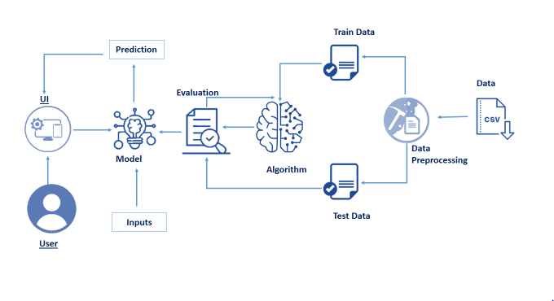
ARCHITECTURE:

Slide 5
Project Flow
Machine Learning Model
Data Collection.
Collect the dataset or Create the dataset
Data Preprocessing.
Import the Libraries and the dataset.
Checking for Null Values.
Data Visualization.
Handling Missing Data.
Label encoding And One Hot Encoding.
Feature Scaling.
Splitting Data into Train and Test.
Model Building
Training and testing the model
Evaluation of Model
Application Building
Create an HTML file
Build a Python Code
UI
The user interacts with the UI (User Interface) to enter the data
Entered data is analyzed by the model which is integrated
Once the model analyses the input, the prediction is showcased on the UI

Slide 6
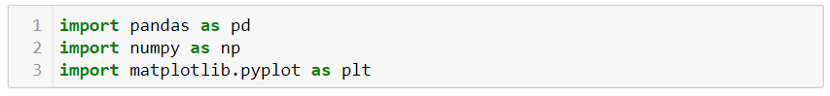
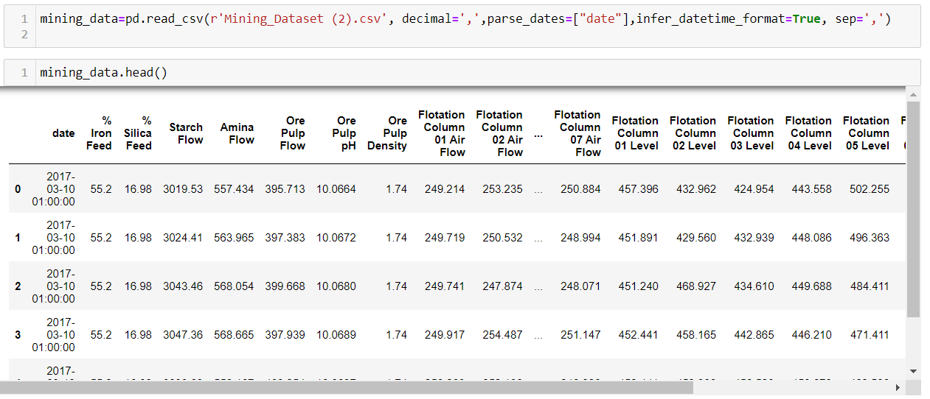
Machine Learning Model
Importing Libraries
Reading the dataset and Viewing the fields.

Slide 7
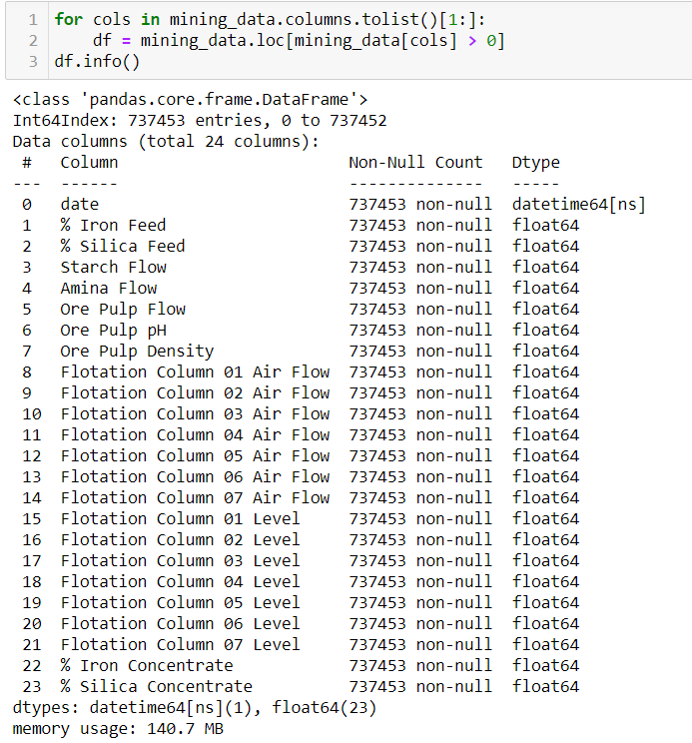
Information about the columns in the dataset.

Slide 8
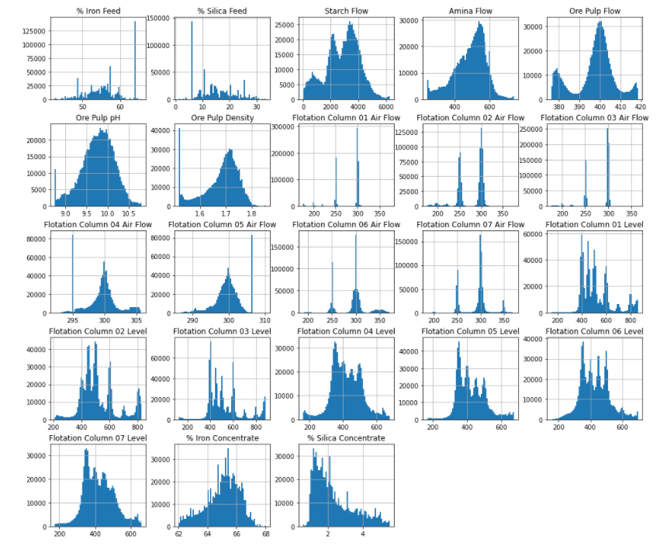
Histogram Visualization of Columns

Slide 9
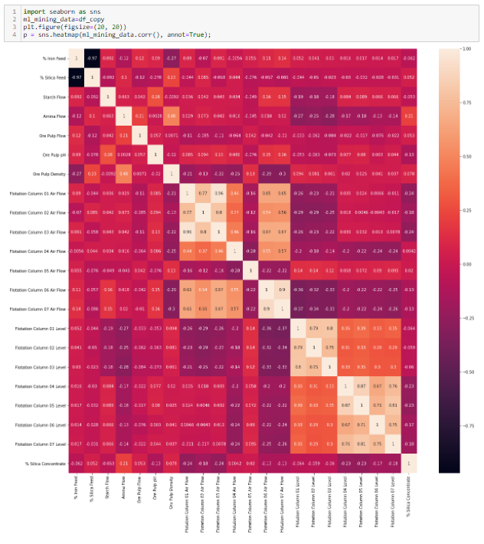
HeatMap Visualization of Columns

Slide 10
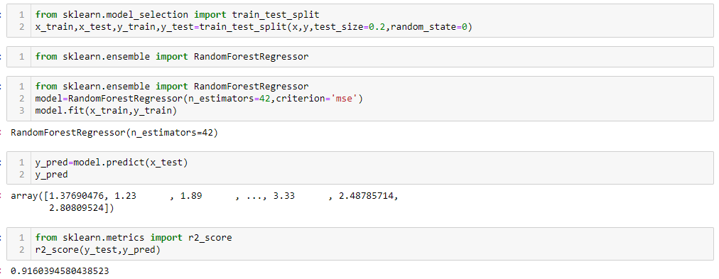
Training and Splitting Data
Applying Ensembled modelling and Predicting the accuracy of the Model

Slide 11
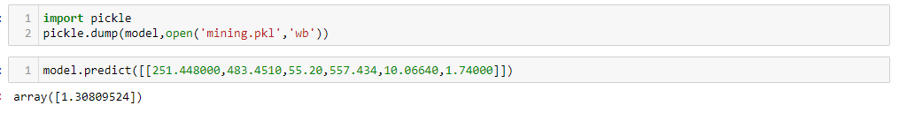
Dumping the model
Saving it as PKL file to access it in Flask

Slide 12
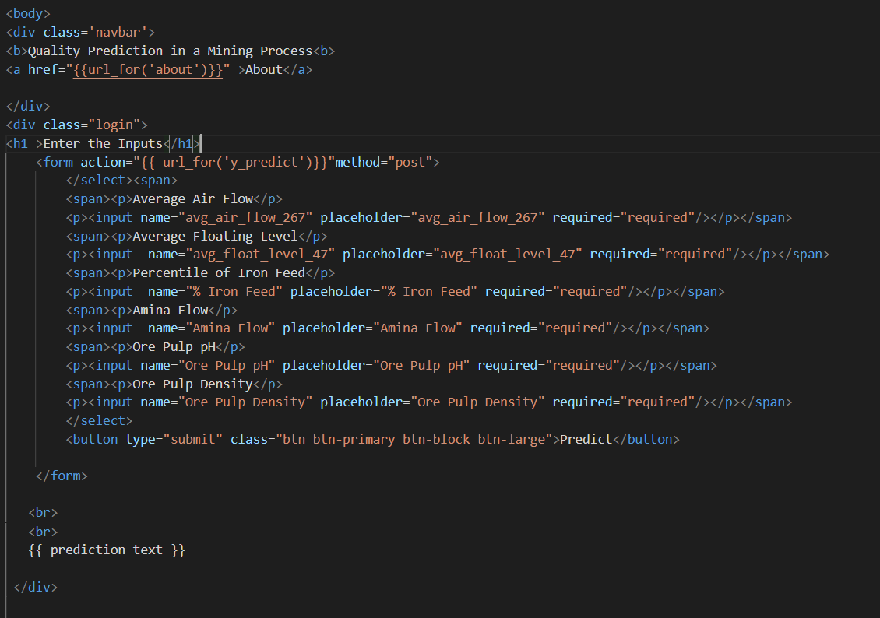
UI
HTML File for the website

Slide 13
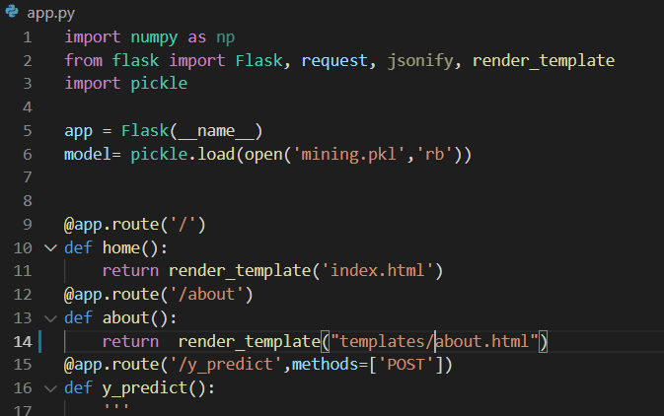
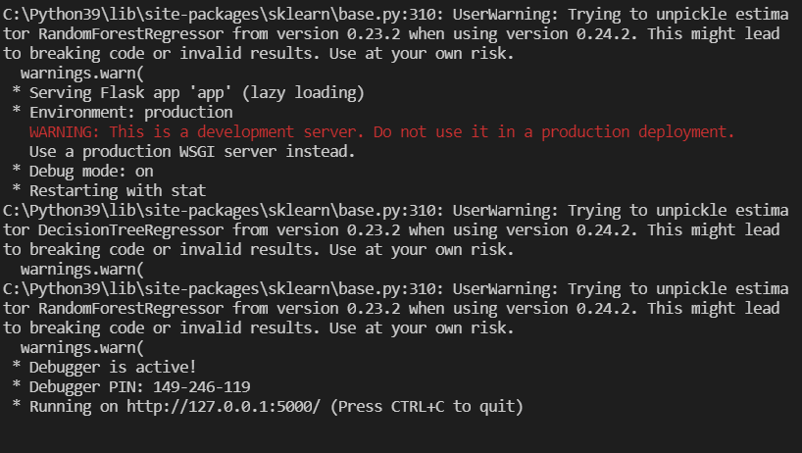
UI
Creating a Flask Application and Accessing the Machine Learning Model
Running the Flask Application (Deployment)

Slide 14
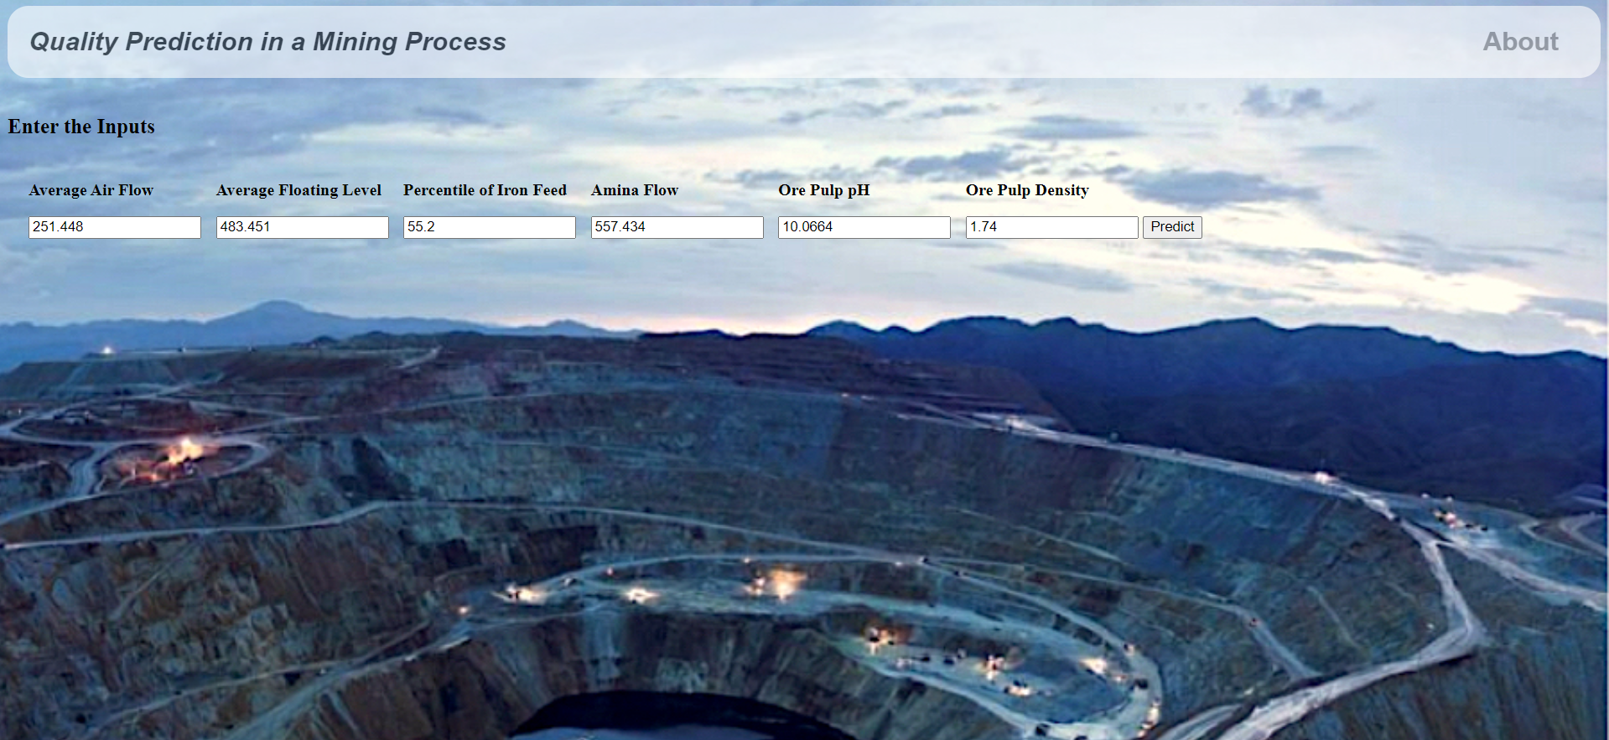
Output UI and Percentages of the inputs.

Slide 15

Predicting The Quality.

Slide 16


